Slide 1
TAB as a Career Path
By Associated Air Balance Council

Slide 2
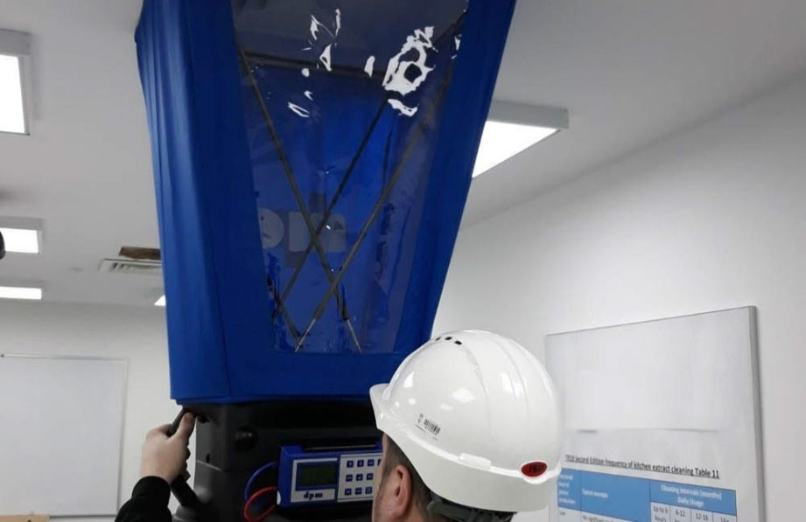
What is Testing, Adjusting, and Balancing?
HVAC Testing, Adjusting and Balancing (TAB) is a crucial step for ensuring proper operation of a commercial building's HVAC and other environmental systems in a building to produce the design objectives.
Have you ever been in an office that's freezing in one room, and very hot in the other? They need TAB!

Slide 3
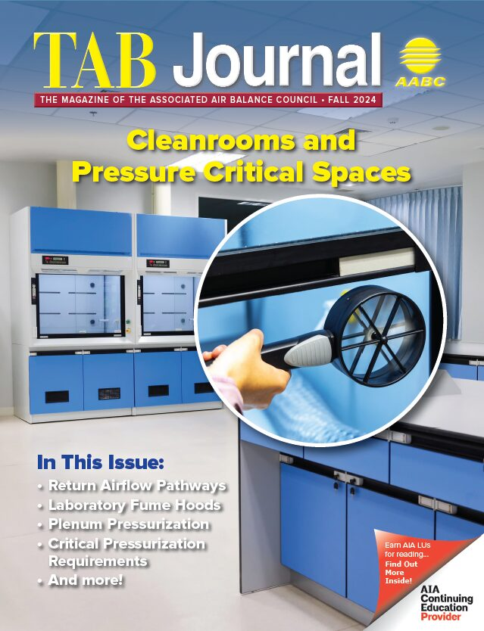
TAB Work is not akin to other trades like plumbing, roofing, drywall installing..
TAB is a clean, professional field, that requires critical thinking and problem solving every day
Every project is an investigation, every solution is different

Slide 4
What is the reason for Test and Balance?
Most energy consuming systems require HVAC test and balance to operate properly and efficiently.
Scenario: Data Centers need an efficient way to keep their equipment cool, but the facility does not require human comfort. Data centers can be cooler than human comfort to manage the heat created from equipment to prevent damage.
Scenario: Hospitals require human comfort and the prevention of the spread of germs through ventilation systems.
Scenario: An indoor grow facility requires precise control over temperature and humidity levels.

Slide 5
What Place Require HVAC TAB Services?
Office Buildings
Restaurants
Hospitals
Museums
Data Centers
K-12 Schools
Universities
Correctional Facilities
Industrial Plants and Warehouses
Government Buildings
Laboratories
Pharmaceutical Manufacturing Facilities
Cleanrooms
Hotels and Resorts
Airports and Transportation Hubs
Arenas and Stadiums
Military Bases
Retail Stores and Shopping Malls

Slide 6
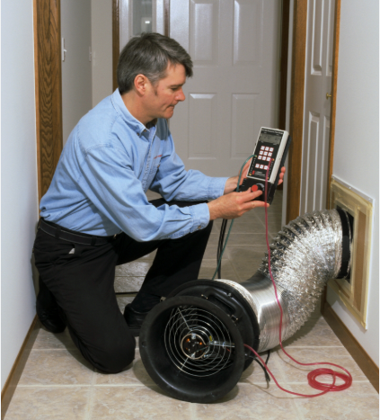
Realm of TAB Specialty Activities
Specialty Enclosures and Systems
Laboratories (Labs and Fume Hoods (BSC)
Data Centers
Kitchens
Building / Stairwell Pressurization
AAALAC accreditation
AHU and Ductwork pressure testing
Picture Source: Wikipedia

Slide 7

Skills Required
Mechanical
Attention to detail
Problem Solving
Resilience
Technical
Communication
Mathematical
Electrical
Leadership

Slide 8
Career Path
Engineering Degree or background in contracting trades (controls, mechanical contractors, sheet metal companies, etc.)
Engineering/Technology degree or other technical training, including background in trades
Build experience through training and projects
Work for an AABC certified TAB firm to become a TBT
Obtain a certification (like TBE)

Slide 9
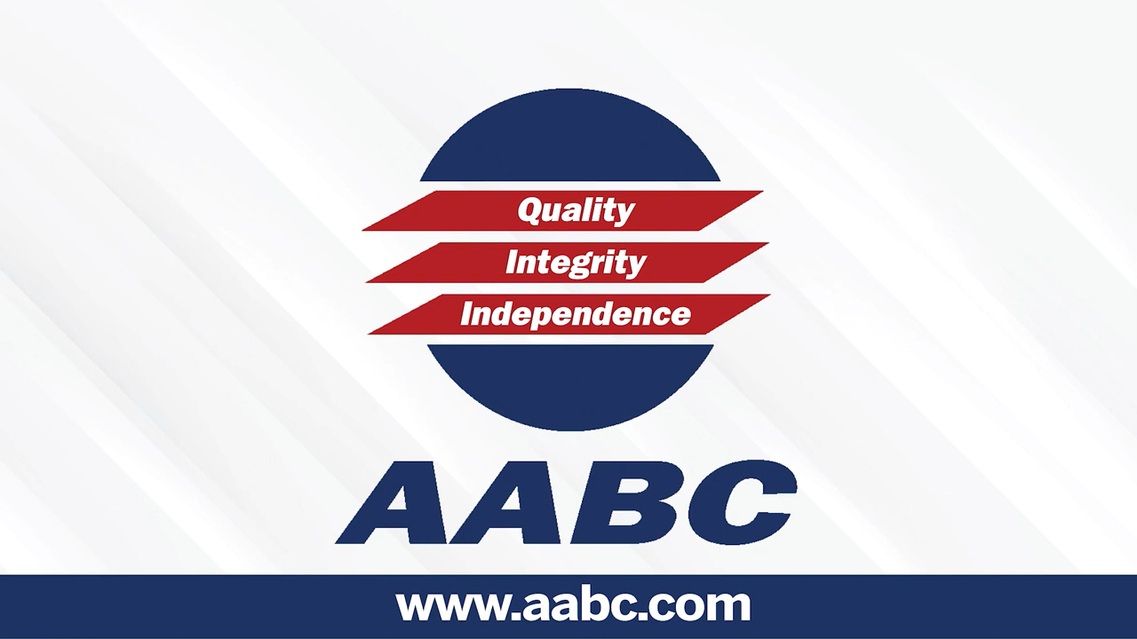
Career Story:

Slide 10
Industry Outlook
The demand for HVAC systems within commercial buildings and residential complexes is increasing and will drive TAB market Growth¹
Increasing Demand for Water TAB Service is Driving the Market Growth¹
Test and Balance is a rapidly growing field driven by the increasing demand for energy efficiency in commercial buildings. From schools and universities to hospitals, pharmacies, and laboratories, every project presents unique challenges. Test and Balance Technicians ensure HVAC and mechanical systems perform as intended by the engineer of record - optimized for comfort, safety, and maximum energy efficiency.
1 https://www.researchandmarkets.com/reports/5847265/testing-adjusting-balancing-services-market

